Slide 1


Shipwright: A Human-in-the-Loop System for Dockerfile Repair
Artifact: https://github.com/STAR-RG/shipwright
Jordan Henkel*§, Denini Silva†§, Leopoldo Teixeira†, Marcelo d’Amorim†, and Thomas Reps*
§Equal contributions
*University of Wisconsin–Madison †Federal University of Pernambuco

Slide 2
What is Docker?
60 second overview

Slide 3
Docker is a tool for lightweight virtualization
Docker (high-level) helps developers with things like:
Continuous integration
Setting up reproducible development environments
Deploying software to cloud vendors

Slide 4
Docker is a tool for lightweight virtualization
Docker (low-level) is used for:
Building images (from Dockerfiles)
Running containers (from images)
A good analogy is source code, executables, and processes: you can build an executable (from source); and, using that executable, you can run one (or many) processes.

Slide 5
We’ll focus our attention here, on the build step
source : executable : process
::
dockerfile : image : container
In particular, we’ll look at broken builds and automated repair

Slide 6
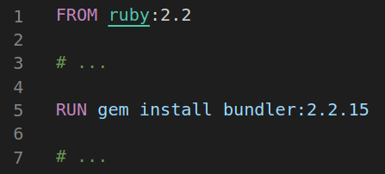
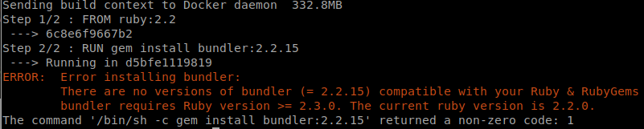
A (Broken) Dockerfile
Image Build (failed)

Slide 7
So what’s the problem?
?
Approx. 1 in 4 Dockerfiles from public GitHub repos (with ≥10 stars) fail to build
We filtered (from an existing Dockerfile dataset) ~30k files amenable to automated builds
Of the 30k remaining Dockerfiles, we attempted to build ~20k; in this sample we observed a ~26% build failure rate

Slide 8
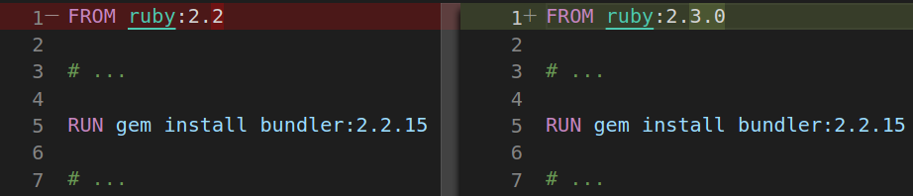
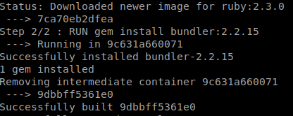
A (Fixed) Dockerfile
Image Build (succeeded)

Slide 9
That’s why we built: Shipwright
Our answer to (automatically) repairing broken Dockerfiles

Slide 10
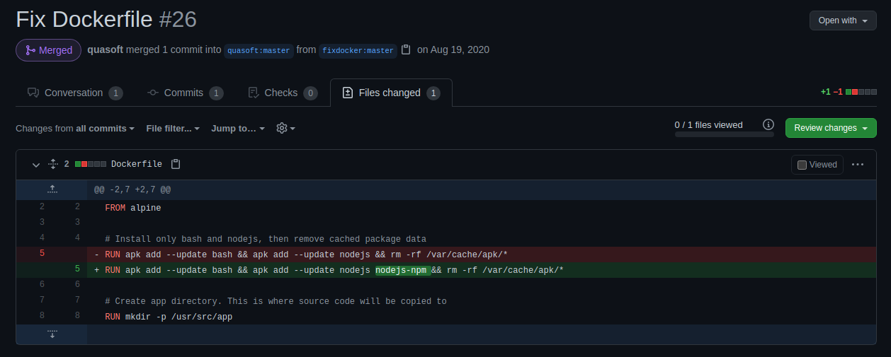
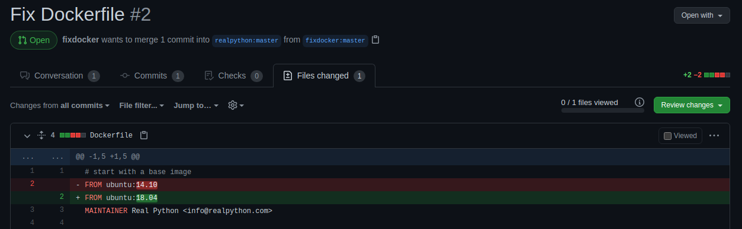
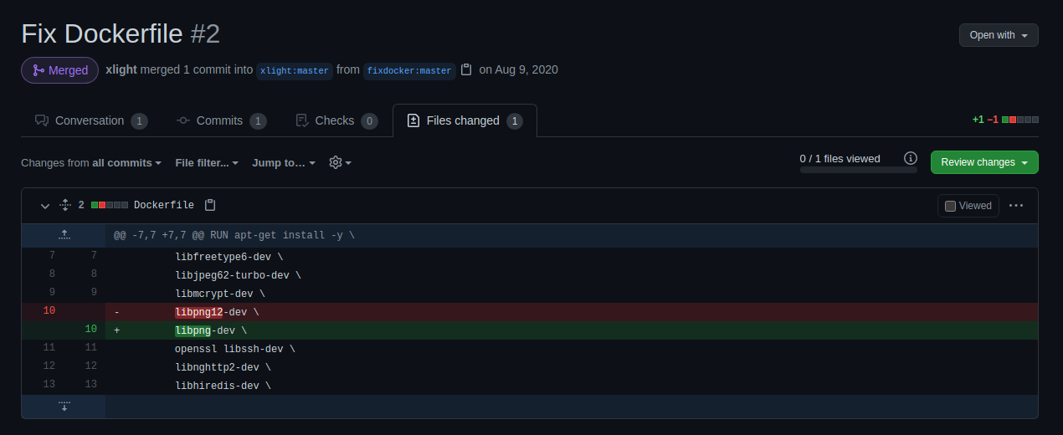
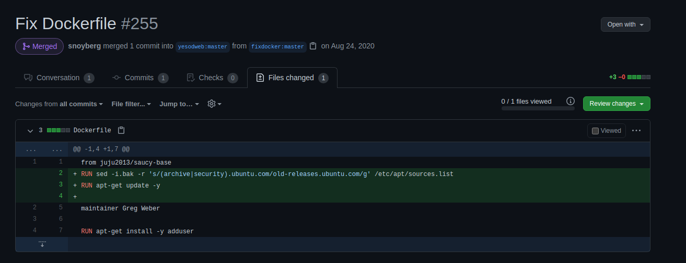
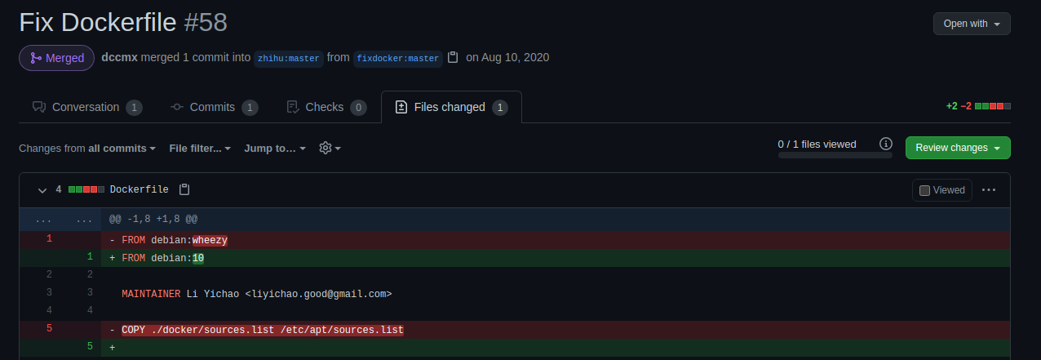

Slide 11
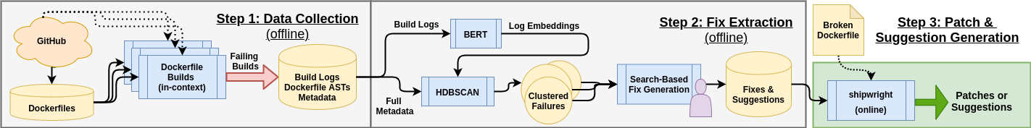
Shipwright operates in three steps: (1) data collection, (2) fix extraction, and (3) patch generation
Step 1: Initially, Shipwright downloads many Dockerfiles, builds them in-context, and save results + metadata to disk.

Slide 12
Shipwright operates in three steps: (1) data collection, (2) fix extraction, and (3) patch generation
Step 2: Following this, Shipwright uses off-the-shelf ML to embed logs from failing builds and HDBSCAN to cluster. The resulting clusters are given to a human who generalizes fixes which are stored in a fix database.

Slide 13
Shipwright operates in three steps: (1) data collection, (2) fix extraction, and (3) patch generation
Step 3: Finally, Shipwright can be used (online) to take a broken Dockerfile and automatically suggest repairs.

Slide 14
Shipwright operates in three steps: (1) data collection, (2) fix extraction, and (3) patch generation
Step 2: Following this, Shipwright uses off-the-shelf ML to embed logs from failing builds and HDBSCAN to cluster. The resulting clusters are given to a human who generalizes fixes which are stored in a fix database.
Step 3: Finally, Shipwright can be used (online) to take a broken Dockerfile and automatically suggest repairs.
We’ll focus on steps 2 & 3 for the remainder of this talk.

Slide 15

If all you have is a hammer...

Slide 16
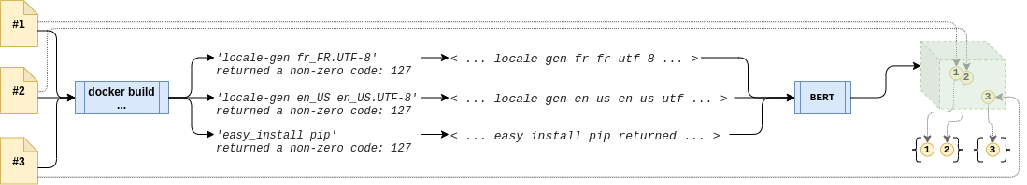
Shipwright takes a variant of BERT [1] (tuned for English sentence similarity) and applies it to the error log from a failing Dockerfile build. This process generates an embedding (a vector of numbers).
Once we have embeddings for each (broken) Dockerfile, we can cluster using off-the-shelf methods (HDBSCAN [2]).
[1] N. Reimers and I. Gurevych, “Sentence-bert: Sentence embeddings using siamese bert-networks,” in Proceedings of the 2019 Conference on Empirical Methods in Natural Language Processing. Association for Computational Linguistics, 11 2019. [Online]. Available: http: //arxiv.org/abs/1908.10084 [2] R. J. G. B. Campello, D. Moulavi, and J. Sander, “Density-based clustering based on hierarchical density estimates,” in Advances in Knowledge Discovery and Data Mining, J. Pei, V. S. Tseng, L. Cao, H. Motoda, and G. Xu, Eds. Berlin, Heidelberg: Springer Berlin Heidelberg, 2013, pp. 160–172.

Slide 17
Two takeaways from building Shipwright
(1) ML can make things easier!
Our approach to clustering isn’t sophisticated.
We live in a world where super-large off-the-shelf models can be applied in many domains to produce decent results (even without fine-tuning).
(2) Humans rock!
Early on, we realized that a completely automated approach would be too limited to be of much use.
By making the work for a human easier we create a tool that is capable of providing actionable fixes in more scenarios.

Slide 18
~42%
We submitted 45 pull requests of which 19 are (currently) accepted.

Slide 19
~19%
We can fix build-failure-inducing issues in ~19% of the broken files we collected.
Comparable (static) tools binnacle and hadolint can only detect possible issues in ~21% and ~34% of the broken files, respectively.

Slide 20
~23%
In the Dockerfiles that were broken (at the time of our analysis) but later fixed, Shipwright produces an equivalent repair in 23/102 cases.

Slide 21

Shipwright: A Human-in-the-Loop System for Dockerfile Repair
Thanks for watching!
^ Artifact

